Slide 1
Running behat scripts in to Sauce labs for cross browser testing
By
kirubanand

Slide 2
installation process
Download sauce lab from internet and set the env path.
Create a account in sauce lab
Once you created a account in sauce lab then u wil get the username and access key.
Username and access key is important for executing automation scripts.

Slide 3
Advantanges of sauce lab
Sauce Labs lets you do automated UI and browser testing in the cloud. With no infrastructure, VMs, or browsers to install or maintain you can run automated tests hassle-free. Run your automated cross-browser tests on 350+ browser/OS platforms.

Slide 4
Browser/OS Support & Test Coverage
Similarly, automated testing can allow companies to cover vastly more test cases and a much higher percentage of code. This means you can be more confident knowing you’ve tested more of your app for errors. Additionally, since automated testing scripts can be run quickly and used over and over, you can easily increase the number of browser/OS platforms you’re testing on.

Slide 5
Automated Testing on Sauce - Added Benefits
The Sauce Labs platform provides additional features that make testing quicker and easier. Screenshots, videos, and console logs help developers and testers identify issues faster, and built-in debugging tools speed up debugging. Breakpoints allow users to take control of running tests to investigate problems. Sauce Labs accounts also come with unlimited manual testing minutes, so you can augment your automated testing.
Plus, running your automated tests on the Sauce cloud allows you to scale your testing instantly. Once you’re hooked on automated UI testing, maintaining enough infrastructure to meet your testing demands can be difficult. With Sauce, capacity is instantly scalable, so you can grow your testing along with your product.

Slide 6
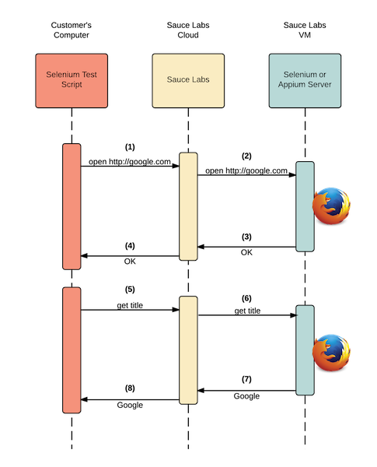
sauce workflow

Slide 7
Profile added into behat yml file
behat-saucelabs:
context:
parameters:
sauce_enabled: 'TRUE'
extensions:
Behat\MinkExtension\Extension:
selenium2:
browser: firefox
wd_host: kkirubanand:e47516d2-dec2-4f17-84f9-c791ce4511e2@ondemand.saucelabs.com/wd/hub
capabilities: { "platform": "VISTA", "browser": "firefox", "version": "15"}

